Slide 1
LINCNODE installation and COMMISSIONING training
Alexander V. klekachev

Slide 2
Outline
Lincnode introduction
Lincnode installation
Commissioning process
Commissioning tool operation

Slide 3
Lincnode introduction (1)
Cloud services
Small form-factor IoT gateway
Monitoring data from ADB Safegate CCR regulators
Uses cellular network to transfer data to the cloud
Supports MODBUS RTU (RS485) and MODBUS TCP connections
Supports MCR2 and MCR3 MODBUS protocols
Supports CRE and MCR3 CCRs
GSM, LTE CAT-M1, NB-IOT
. . .
Modbus interface

Slide 4
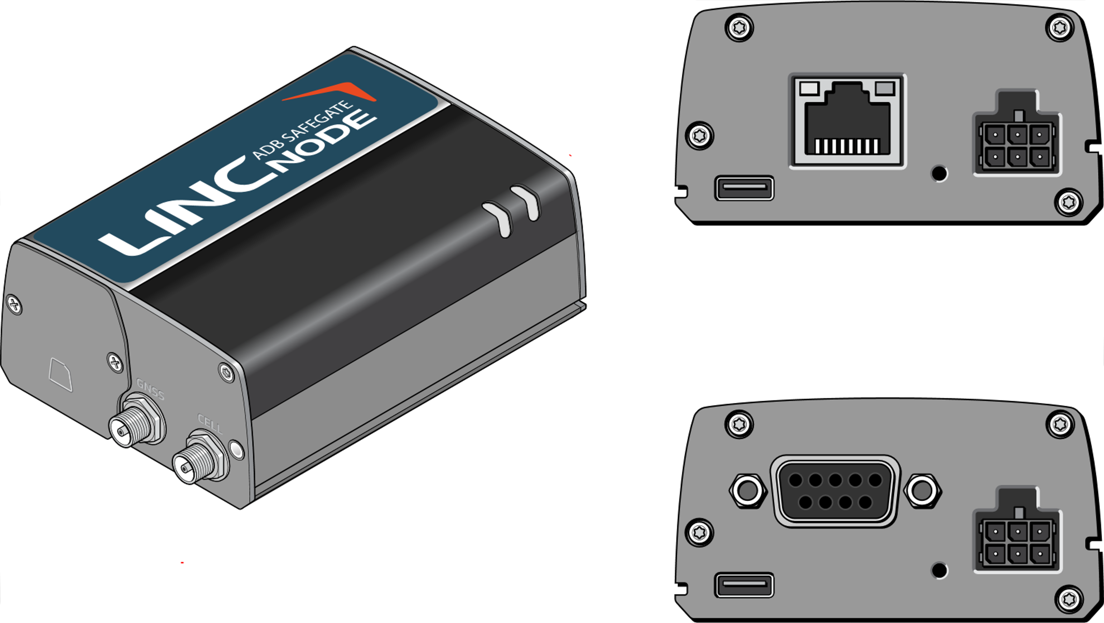
Lincnode introduction (2)
Ethernet version
Status LED
Micro-USB
Power connector
Serial version
Cellular antenna connector
Micro-USB

Slide 5
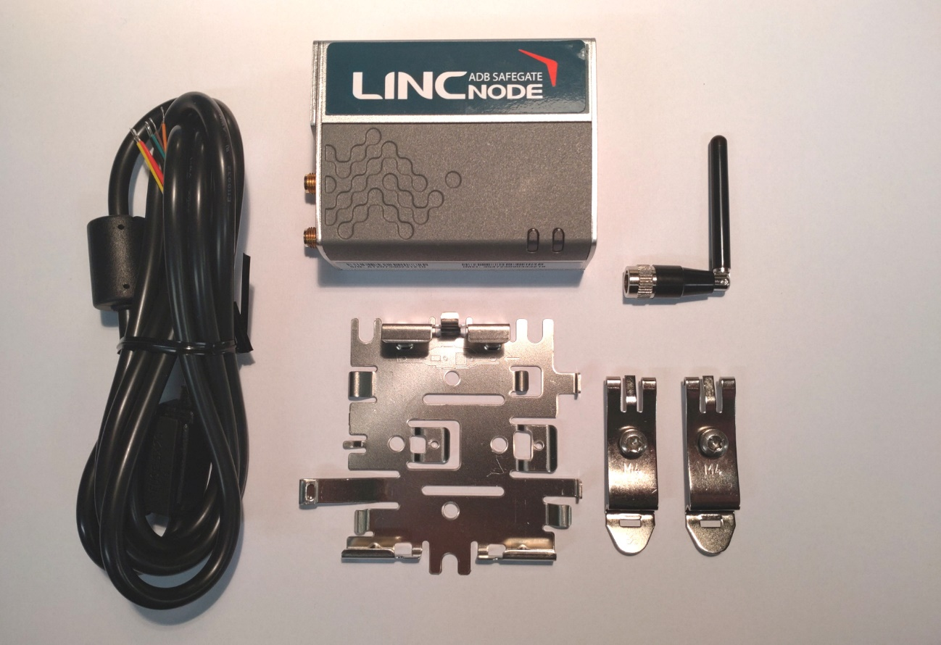
Lincnode installation (1)
Power supply (not shown)
Power cable
Antenna
DIN rail
clips (2x)
Mounting bracket

Slide 6
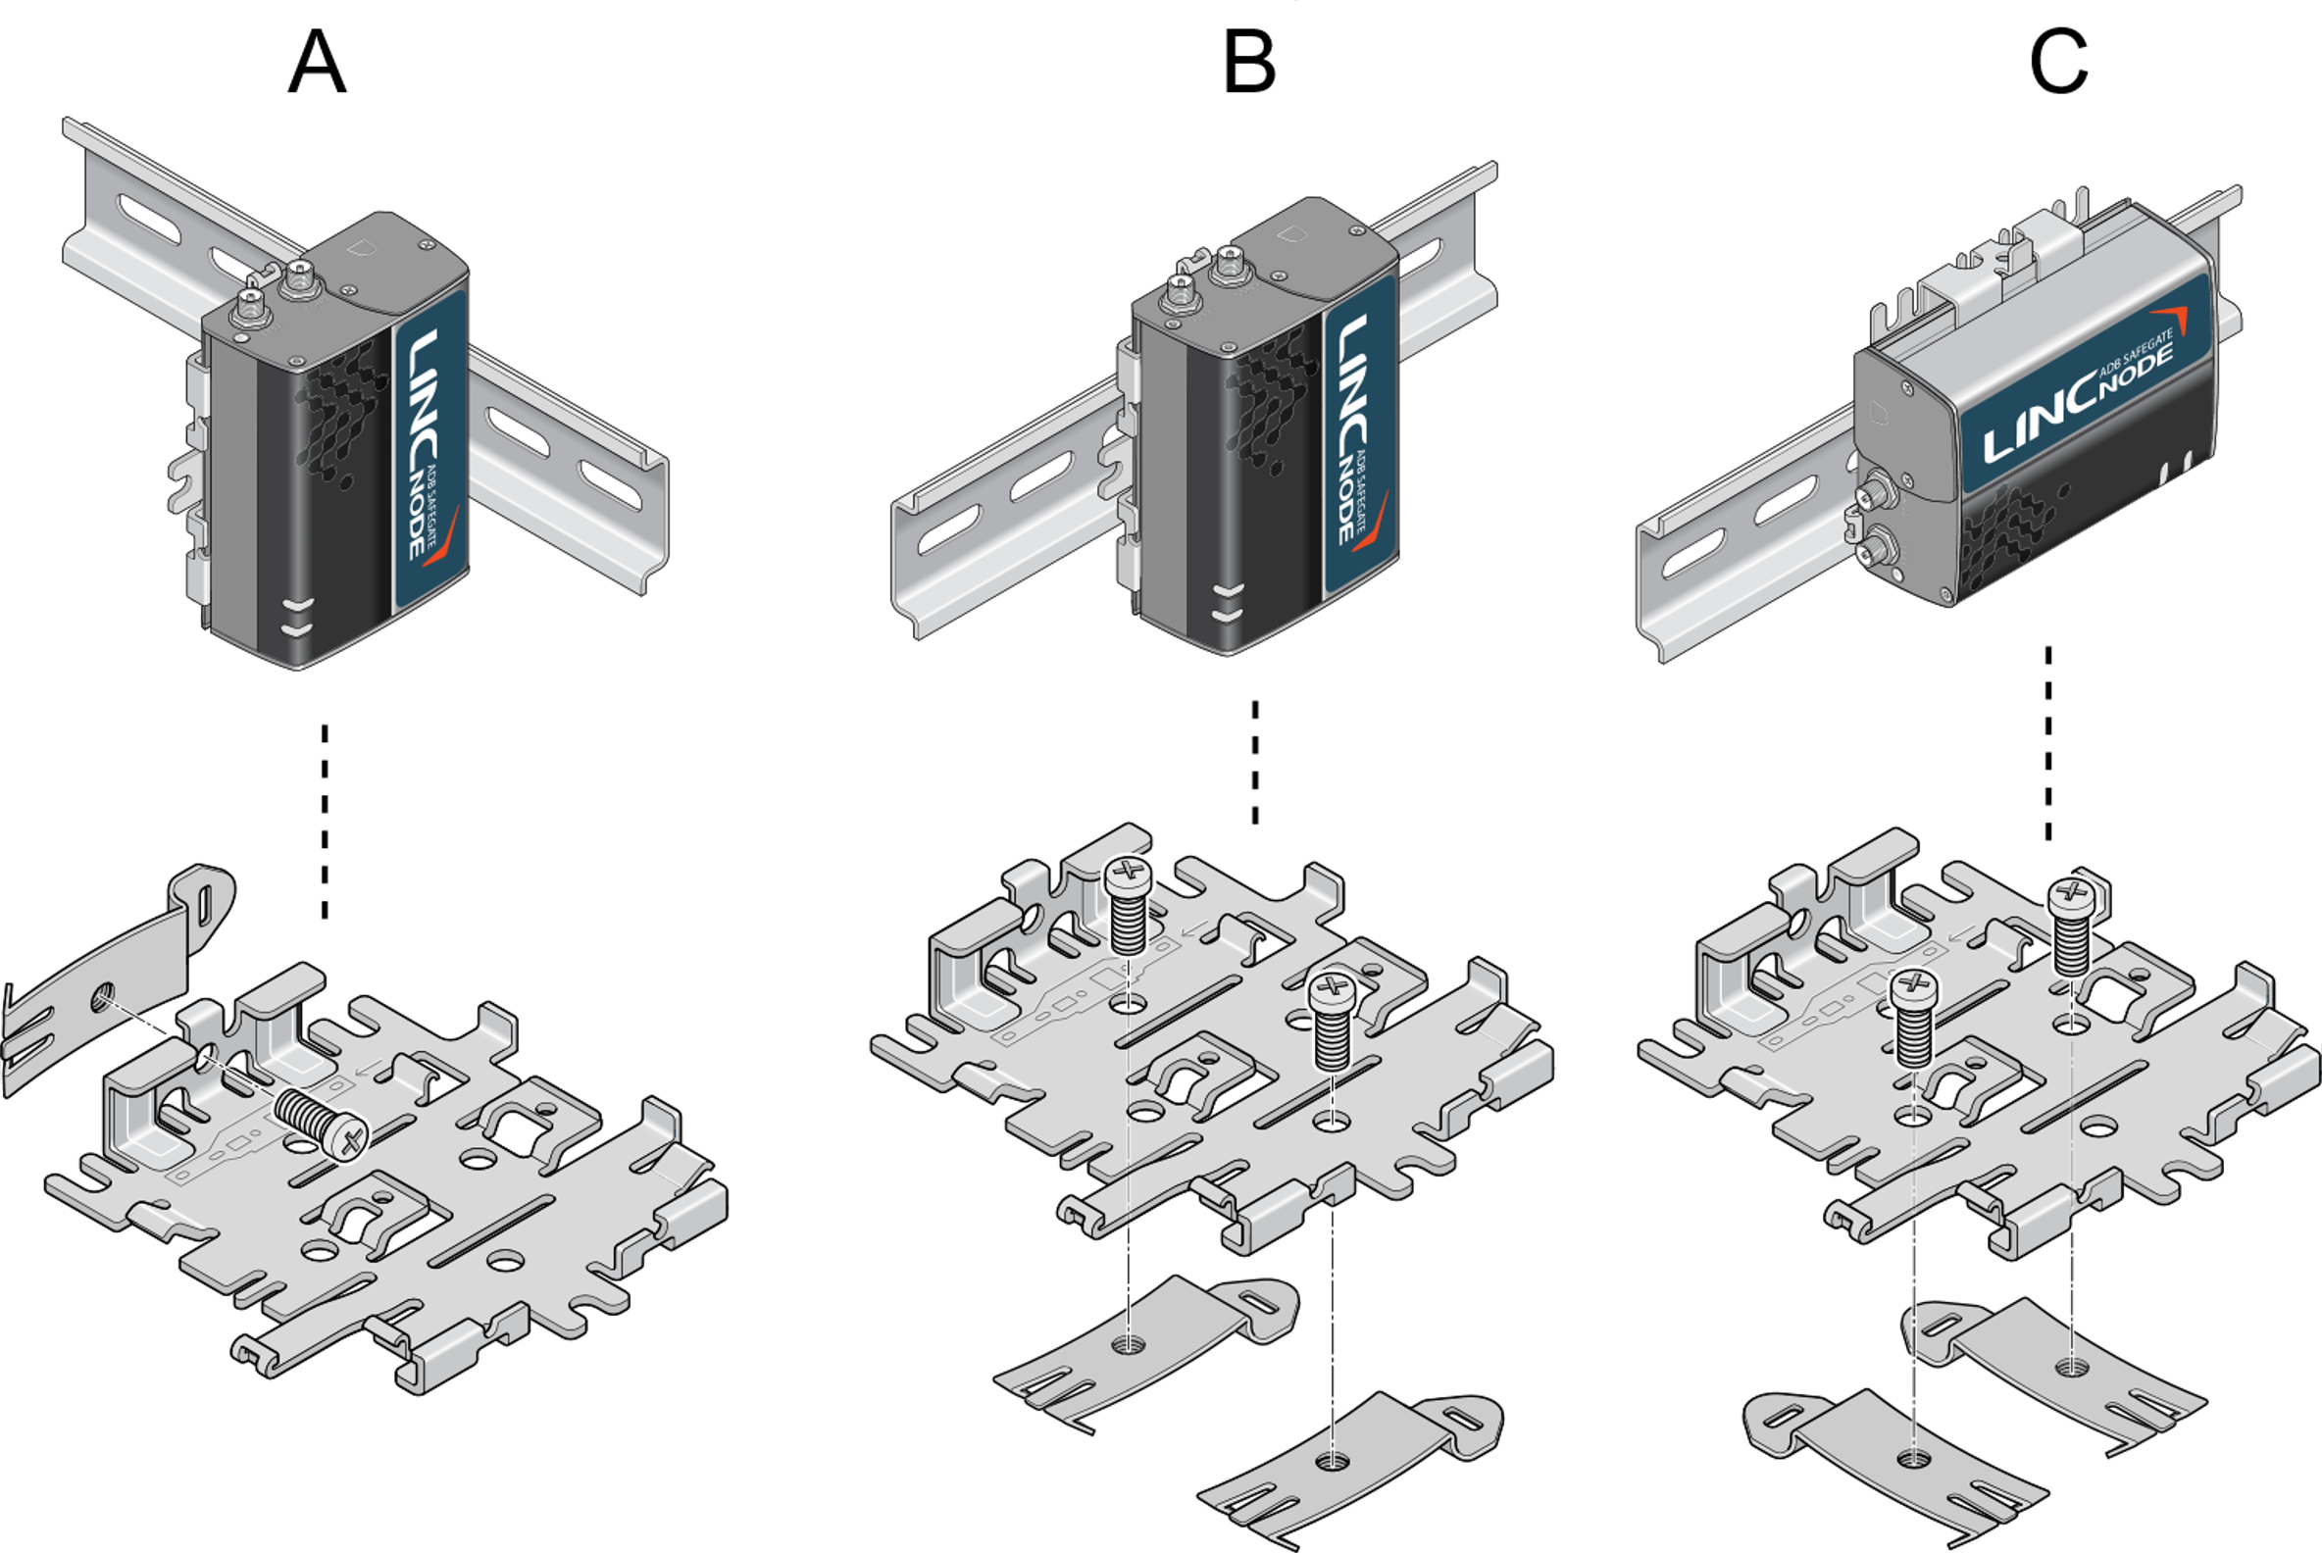
Lincnode installation (2)

Slide 7
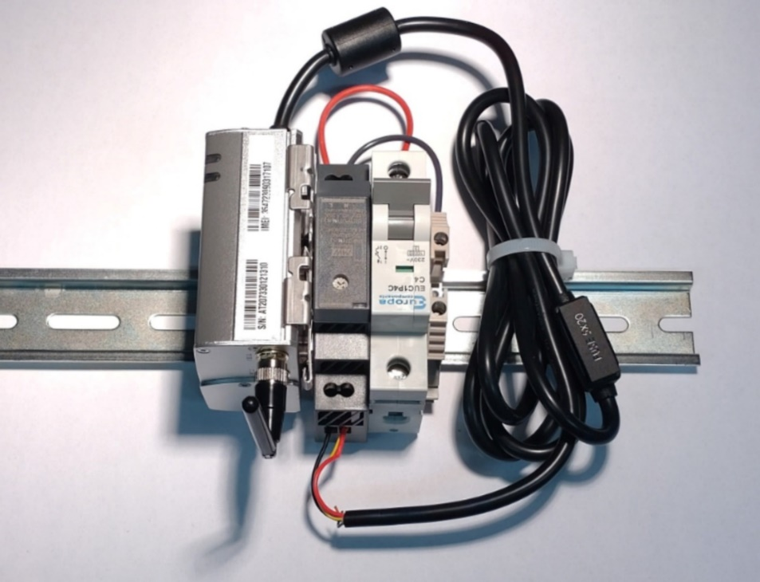
Lincnode installation (3)
Power supply
Circuit breaker

Slide 8
Commissioning process (1)
Install the Lincnode device following the instructions
Perform all necessary connections between the CCRs and the device
In case of Serial device, make daisy-chained RS485 connections of CCRs (up to 16 CCRs supported)
In case of Ethernet device, use Ethernet switch to connect the Lincnode with the CCRs (up to 4 CCRs supported)
Power Lincnode device
Connect Lincnode device to the PC using micro-USB cable
Start the Commissioning Tool application

Slide 9
Commissioning process (1): Serial device details
One must enable the termination of the RS485 interface at the very last unit in the daisy-chained net
Follow the instructions for a particular CCR on how to set the termination
Additionally, termination needs to be enabled in the Lincnode device
This is achieved via Commissioning Tool software
RS485 interface

Slide 10
Commissioning Tool key steps
Check cellular connectivity status:
Shows whether device is registered on the network
Configure the Modbus interface:
In case of Serial device set RS485 parameters
In case of Ethernet device set the IP Address and mask (CIDR format)
Configure Modbus assets (CCRs):
Define CCR protocol
Define CCR RTU addresses, in case of Ethernet, IP Address and Port
Add as many CCRs as necessary.
Apply device configuration
Device Modbus interface and assets information gets transferred to the device

Slide 11
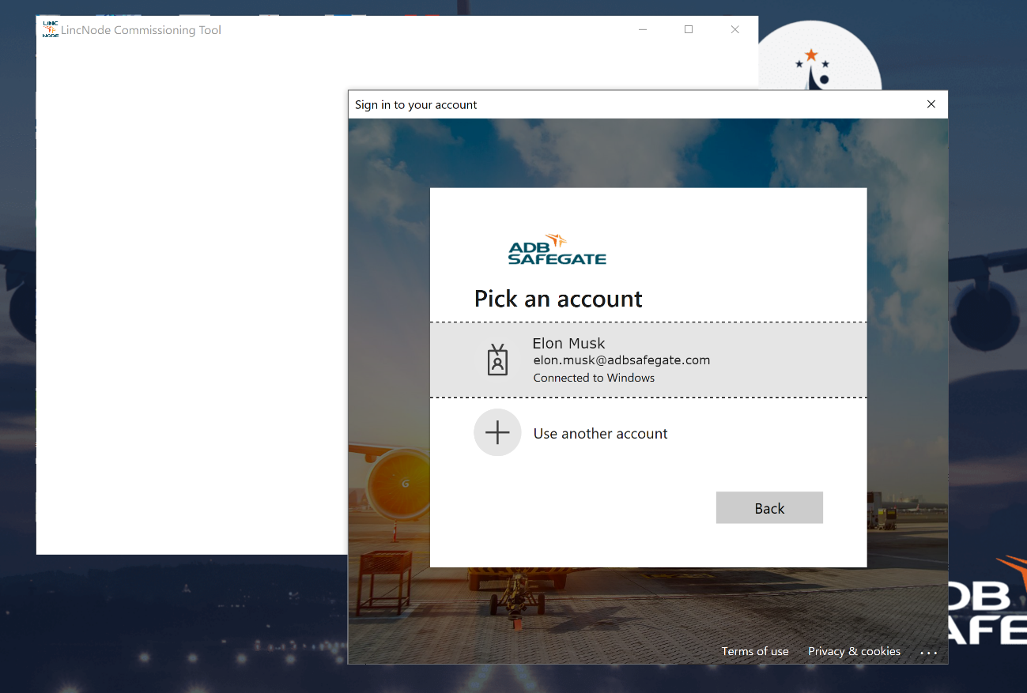
Account selection screen
When starting the application, it will invite you to login into your ADB Safegate account.

Slide 12
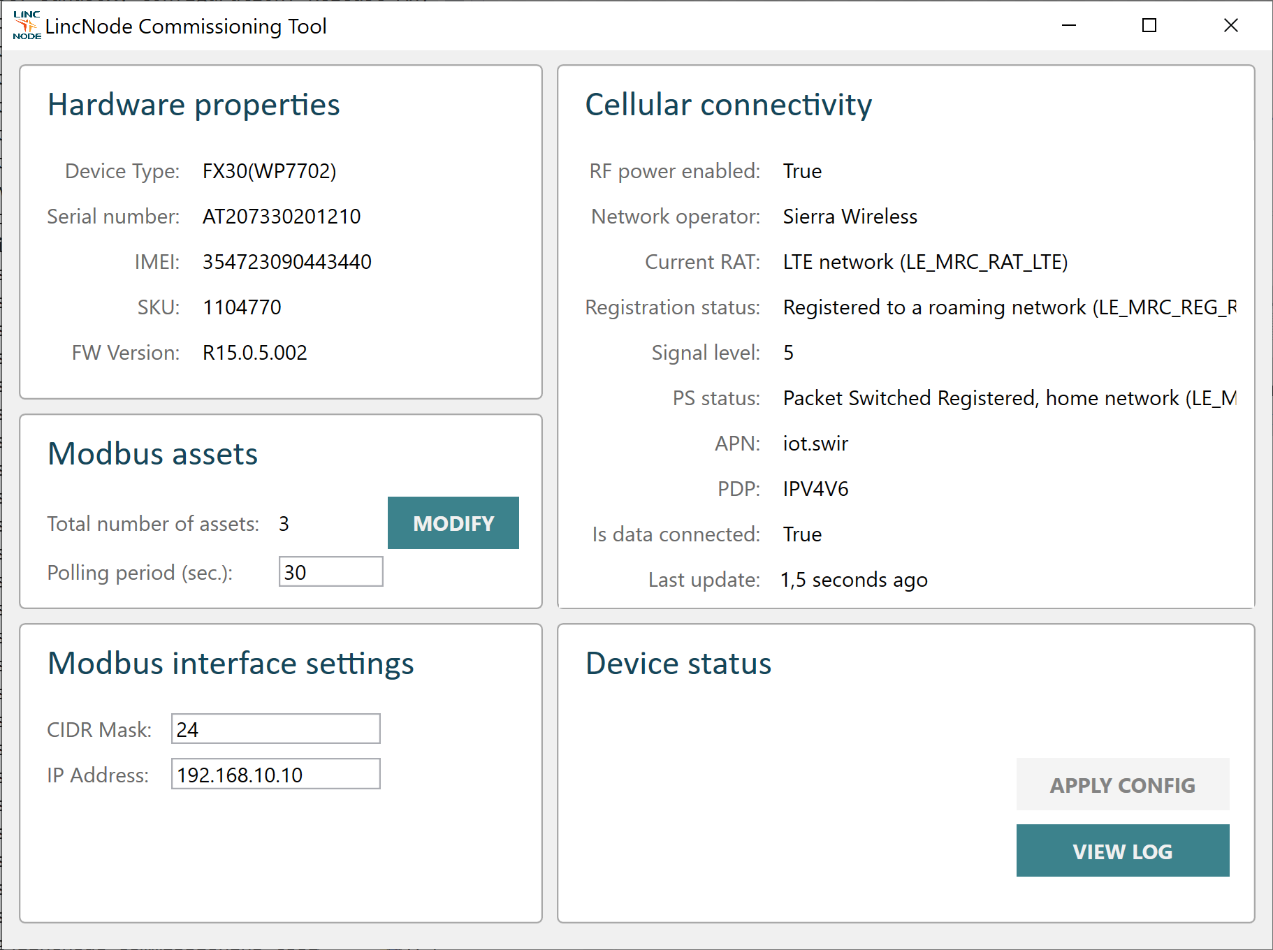
Commissioning Tool: dashboard (Ethernet version)
Device hardware identity
Cellular connectivity status overview
Modbus assets summary
Device configuration status
Modbus interface settings

Slide 13
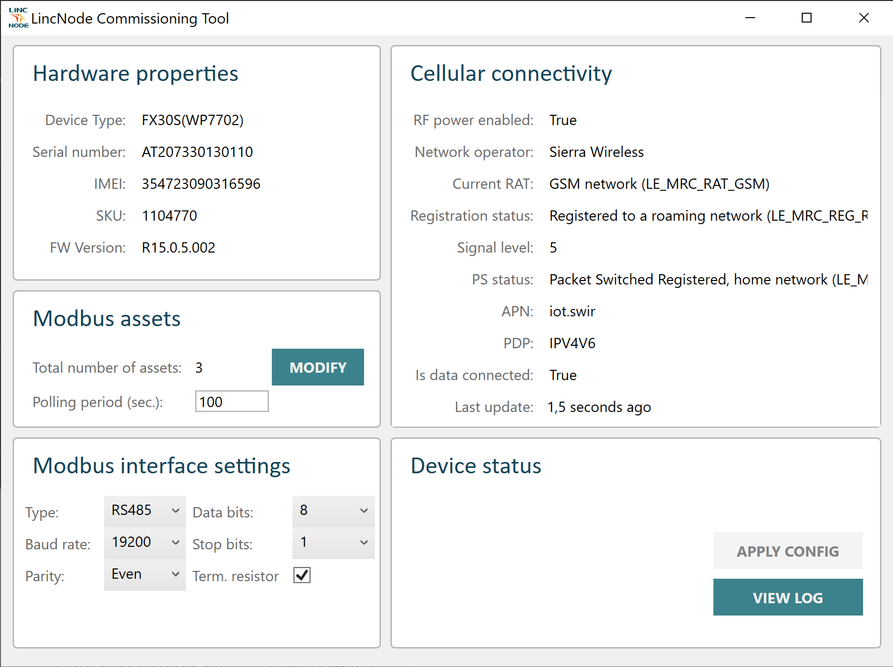
Commissioning Tool: dashboard (Serial version)
Device hardware identity
Cellular connectivity status overview
Modbus assets summary
Device configuration status
Modbus interface settings
Termination resistor

Slide 14
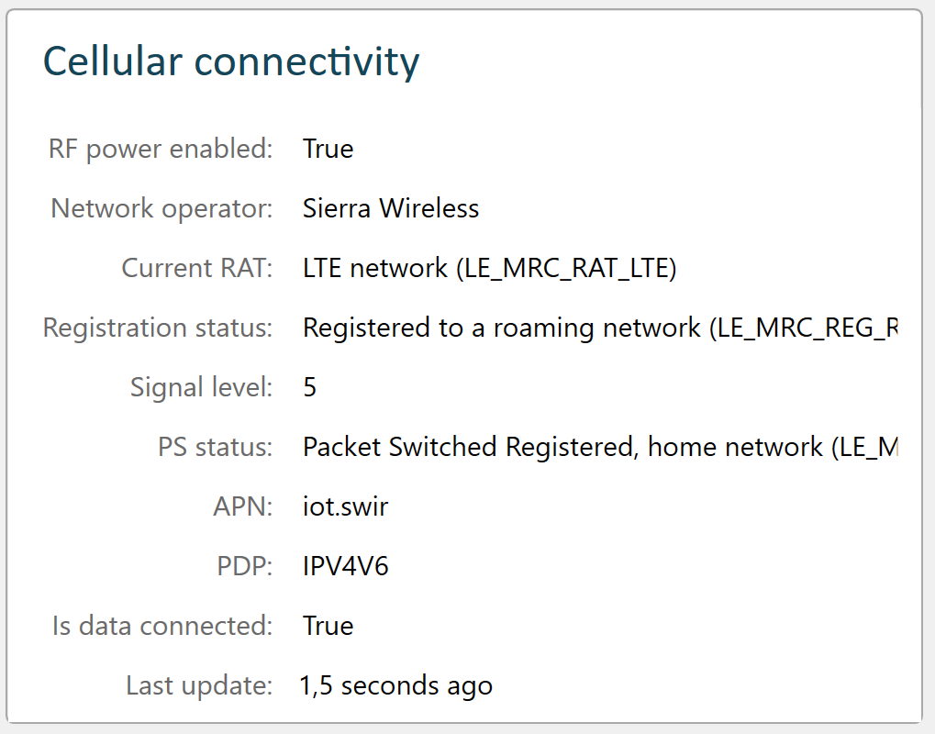
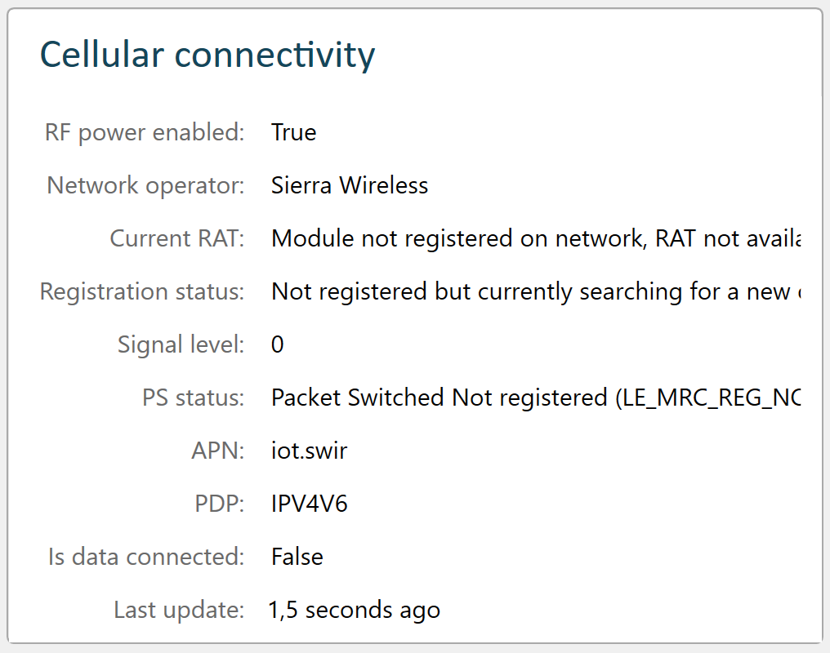
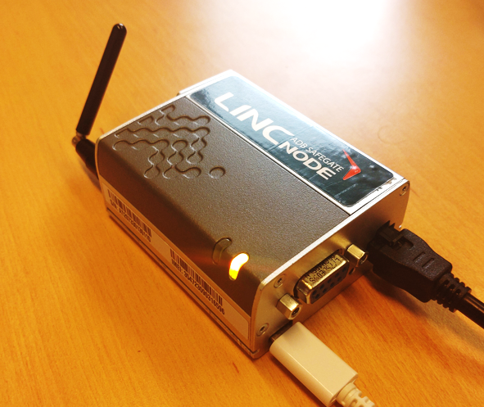
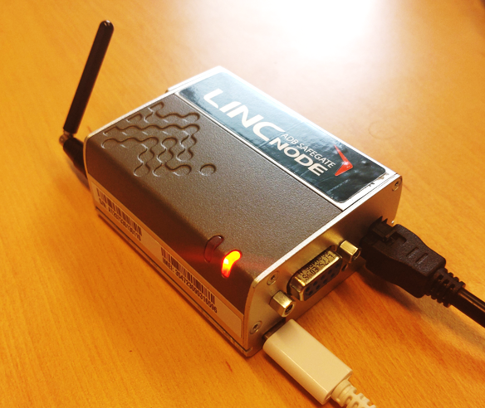
Commissioning Tool: cellular status monitoring
Status LED

Slide 15
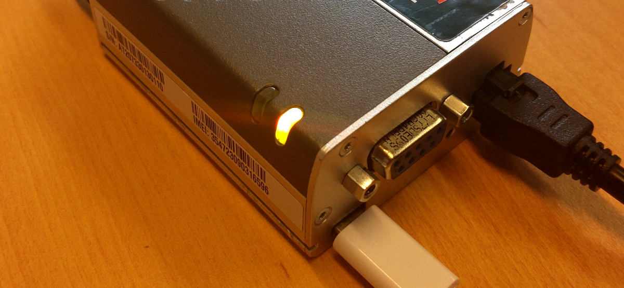
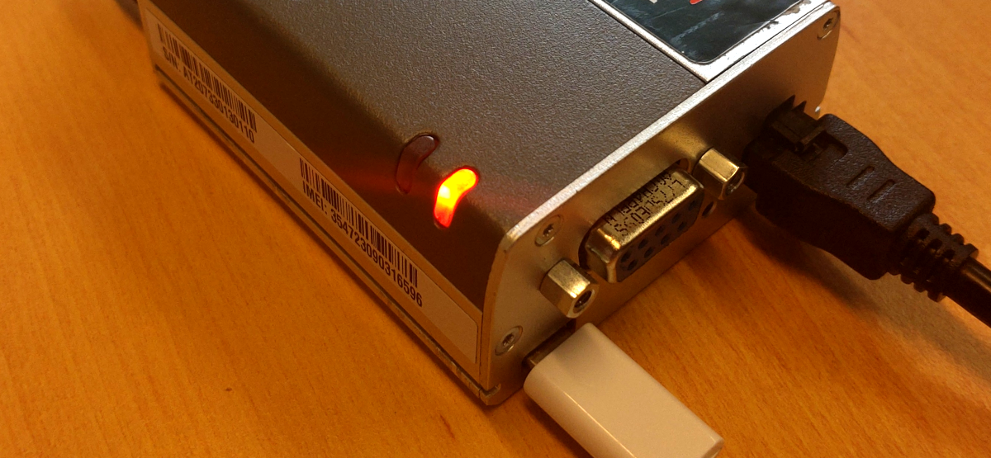
Status LED: amber color
Status LED: red color

Slide 16
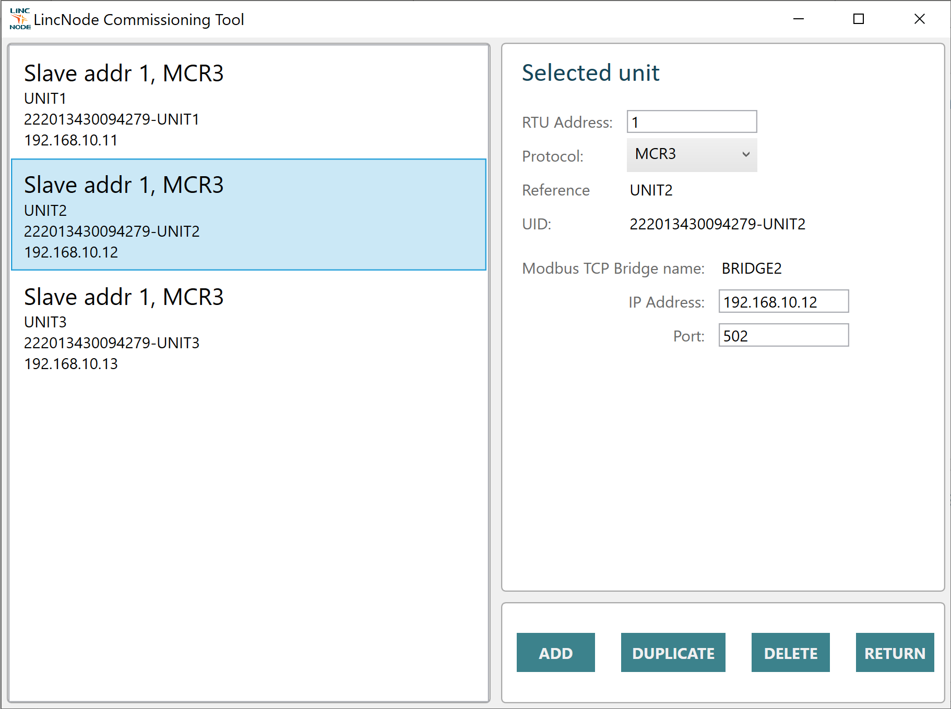
Commissioning Tool: Modbus assets (Ethernet)

Slide 17
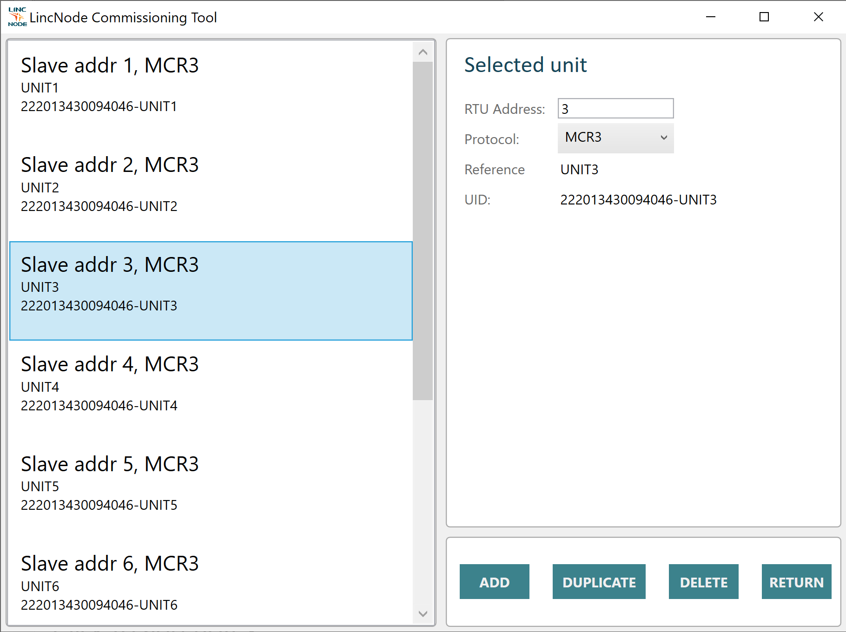
Commissioning Tool: Modbus assets (Serial)

Slide 18
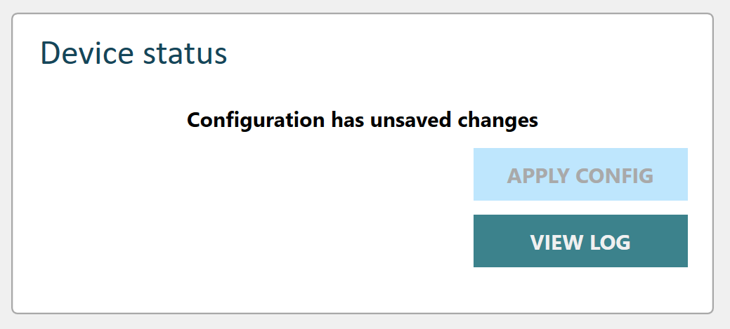
Commissioning Tool: apply configuration
When all parameters set press “APPLY CONFIG” button.

Slide 19
Commissioning Tool: save screenshot of this view (for ALIS)

Slide 20
That’s all folks!

